Slide 1
TCP/IP Network Fundamentals
UEEN2013/UEEN2432
(Topic 07)
Layered Model & Protocols

Slide 2
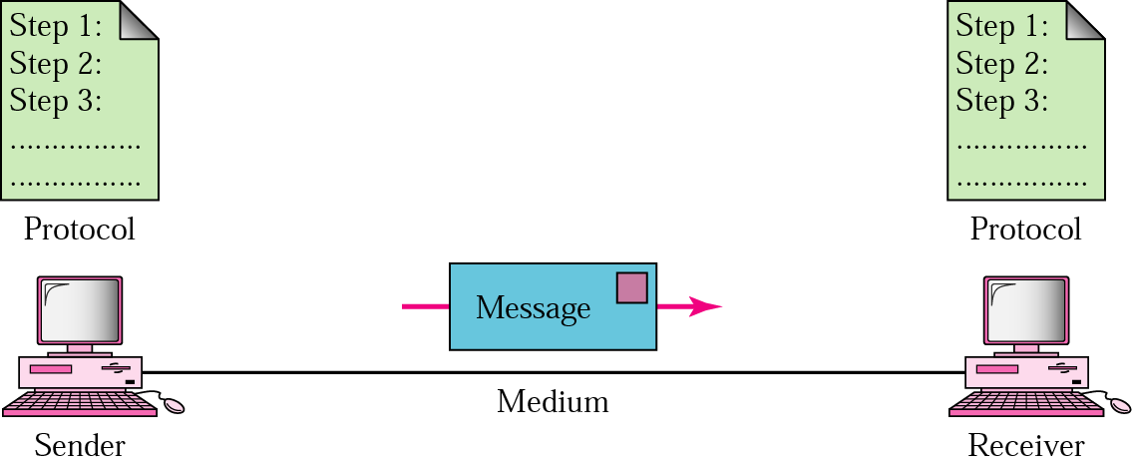
5 components of Data Comm
Message
  Information (data) to be communicated, (e.g. text, number, pictures, sound, video, etc)
Sender
  Device that sends the message, (e.g. computer, telephone, etc)
  Message generator (computer),
  and intermediate sender (relay the message, e.g. router)
Receiver
  Device that receive the message, (e.g computer, telephone, etc)
  End system (computer), and intermediate receiver (e.g. router, repeater)
Medium
  Physical path by which a message travels from sender to receiver, (e.g. wire, cable, fiber, radio wave)
Protocol (the hardest to understand) since it is rather “abstract”.

Slide 3
Definition of Protocol (Wikipedia)
In computing, a protocol is a set of rules which is used by computers to communicate with each other across a network.
A protocol is a convention or standard that controls or enables the connection, communication, and data transfer between computing endpoints.
In its simplest form, a protocol can be defined as the rules governing the syntax, semantics, and synchronization of communication.
Protocols may be implemented by hardware, software, or a combination of the two.

Slide 4
Introduction to Protocol
Protocol represents an agreement between the communicating devices.
  Must have a sender and a receiver
  Without a protocol, two devices may be connected but not communicating in a network.
Protocol has header bytes as management overhead
  The software or hardware in the network add in extra bytes in the data which serves as management purposes.
Protocol has an sequence of network events
  Something happen first before next thing happens
  For example: clients make request, servers make reply

Slide 5

Data Transmission in Packets
In computer networks, data is NOT sent a in continuous stream.
00110001011010111110101010
Data is sent a in packetized form.
  packet by packet
101101
111001
011101

Slide 6
Segmentation of Data & Protocol Header
Data (or a file) is first being segmented (or chopped into pieces) before sent out.
After the segmentation (or chopping), protocol headers have been added at the beginning of each data segment.
In the “header” it normally contain
  Management information for the network
  More importantly, the addresses (e.g: IP address, port number, etc)
Message / Data
segment of message
Chop into
…..
add in
Protocol header
segment of message

Slide 7
The typical functions of Protocol
While protocols can vary greatly in purpose and sophistication, most specify one or more of the following properties:
  Procedures on formatting a message
  How to start and end a message
  Negotiation of various connection characteristics
  Handshaking
  How to detect unexpected loss of the connection, and what to do next
  What to do with corrupted or improperly formatted messages (error correction)
  Termination of the session and or connection.
  Detection of the underlying physical connection (wired or wireless), or the existence of the other endpoint or node

Slide 8
Definition of Layered Architecture
Layered architecture concept depicts an abstract description for layered communications and computer network protocol design.
A layer is a collection of conceptually similar functions that provide services to the layer above it and receives service from the layer below it.
On each layer an instance provides services to the instances at the layer above and requests service from the layer below.

Slide 9
Introduction to Layered Architecture
Our network and communication system is very complex.
Layered architecture is to modularize this complex network system into some manageable layers.
Each layer carries out different functions
  And handled by different experts.
Similar to a computer, a complex machine, which has been modularized into
  Motherboard, monitor, keyboard, network card, video card, etc..

Slide 10
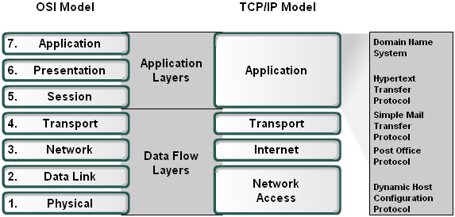
Two Standard Layered Models
In today’s network and data communication, it has been standardized into two models
  7-layer OSI model
  4-layer TCP/IP model

Slide 11
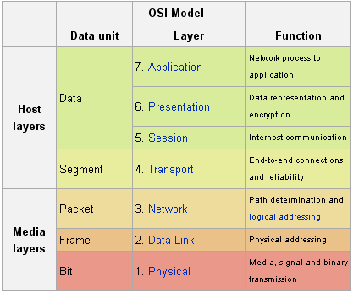
OSI Layered Model
OSI was developed back in 1977, by International Organization for Standardization (ISO).
OSI architecture has begun with two major components:
  an abstract model of networking, with specific functions at each layer,
  a set of specific protocols associated with a particular layer.

Slide 12
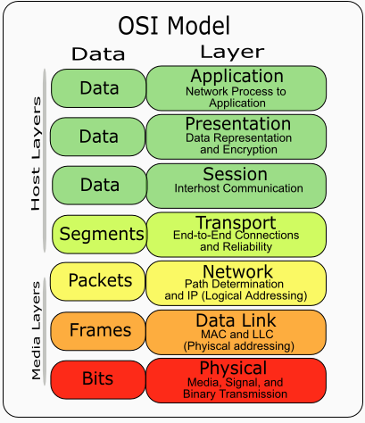
A Note on OSI Model
OSI = Open System Interconnection.
It has 7 layers.
The bottom four layers, physical, data link, network and transport are the same as the 5 –layer model.
Two “extra” layer in OSI (compared to TCP/IP model)
  Presentation and Session
  Assume this 2 layer as part of the application layer in the TCP/IP model

Slide 13
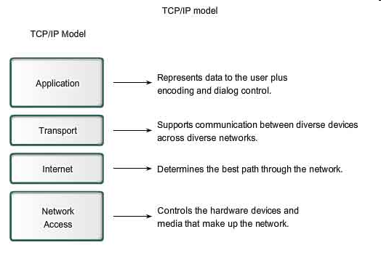
TCP/IP Model
Typical functions for each layer of TCP/IP model.

Slide 14
Internet Layered Model
There are 5 layer in Internet model.
Physical layer is called layer 1
Application layer is called layer 5.
First four layers deals mainly with software
The physical layer (and data link layer) deals with hardware.
Application
5
Transport
4
Software
Network
3
Data Link
2
Physical
Hardware
1

Slide 15
Why Layered Model?
Dealing with complex systems:
Modularization eases maintenance, updating of system
  change of implementation of layer’s service transparent to rest of system
  e.g., change in gate procedure doesn’t affect rest of system
Easy to swap in and out (upgrade) for each layer
Special people trained for each layer

Slide 16
Functions of Internet Model Layers
Application layer (data)
  Service: Application specific (delivery of email, retrieval of HTML documents, reliable transfer of file)
  Functions: Application specific
Transport layer (segment)
  Service: Delivery of data to corresponding process/program between hosts.
  Functions: Connection establishment/termination, error control, flow control, divide data stream into small segments
Network layer (packet)
  Service: Move data packets from source host to destination host
  Functions: Routing, addressing
Data Link layer (frame)
  Service: Reliable transfer of frames over a link, Media Access Control on a LAN
  Functions: Framing, media access control, error checking
Physical layer (signal)
  Service: Translating bit stream into signals,
  Functions: Physical signal transmission and reception

Slide 17
Application Layer
Provides a means for the user to access information on the network through an application.
This layer is the main interface for the user(s) to interact with the application and therefore the network.
Applications built to utilize a protocol, such as FTP, should not be confused with the protocols themselves.

Slide 18
Transport Layer
The Transport layer provides transparent transfer of data between end users, thus relieving the upper layers from any concern while providing reliable data transfer.
The transport layer
  controls the reliability of a given link through flow control,
  segmentation/desegmentation,
    divides streams of data into chunks or packets; the transport layer of the receiving computer reassembles the message from packets
  provides error-checking to guarantee error-free data delivery, with on losses or duplications
  provides acknowledgment of successful transmissions; requests retransmission if some packets don’t arrive error-free

Slide 19
Network Layer
The Network layer
  Network addressing
  Determining routes for sending
  Managing network problems such as packet switching, data congestion and routing
  if router can’t send data frame as large as the source computer sends, the network layer compensates by breaking the data into smaller units. At the receiving end, the network layer reassembles the data.

Slide 20
Data Link Layer
The Data Link layer provides the functional and procedural means to transfer data between network entities and to detect and possibly correct errors that may occur in the Physical layer.
Turns frame into raw bits 100101 and at the receiving end turns bits into packets.
Handles data frames between the Network and Physical layers
The receiving end packages raw data from the Physical layer into data frames for delivery to the Network layer
Responsible for error-free transfer of frames to other computer via the Physical Layer
This layer defines the methods used to transmit and receive data on the network. It consists of the wiring, the devices use to connect the NIC to the wiring, the signaling involved to transmit / receive data and the ability to detect signaling errors on the network media.

Slide 21
Physical Layer
Transmits raw bit stream over physical cable
Defines cables, cards, and physical aspects
Defines NIC attachments to hardware, how cable is attached to NIC
Defines techniques to transfer bit stream to cable

Slide 22
Layered Architecture and Protocol
Each layer has its own protocol
  Application layer protocol: HTTP, FTP
  Transport layer protocol: TCP, UDP
  Network layer protocol: IP
  Data Link layer protocol: ARP
The complexity of the communication task is reduced by using multiple protocol layers:
  Each protocol is implemented independently
  Each protocol is responsible for a specific subtask
  Protocols are grouped in a hierarchy
A structured set of protocols is called a communications architecture or protocol suite.

Slide 23
Addresses in layered architecture
  Transport Layer gives port numbers
  Network Layer gives IP address
  Data Link Layer gives MAC address
The “chunk” of data in
  Transport Layer is called “segment”
  Network Layer is called “packet”
  Data Link Layer is called “frame”
  Physical Layer is called “bits” or “bit streams”

Slide 24
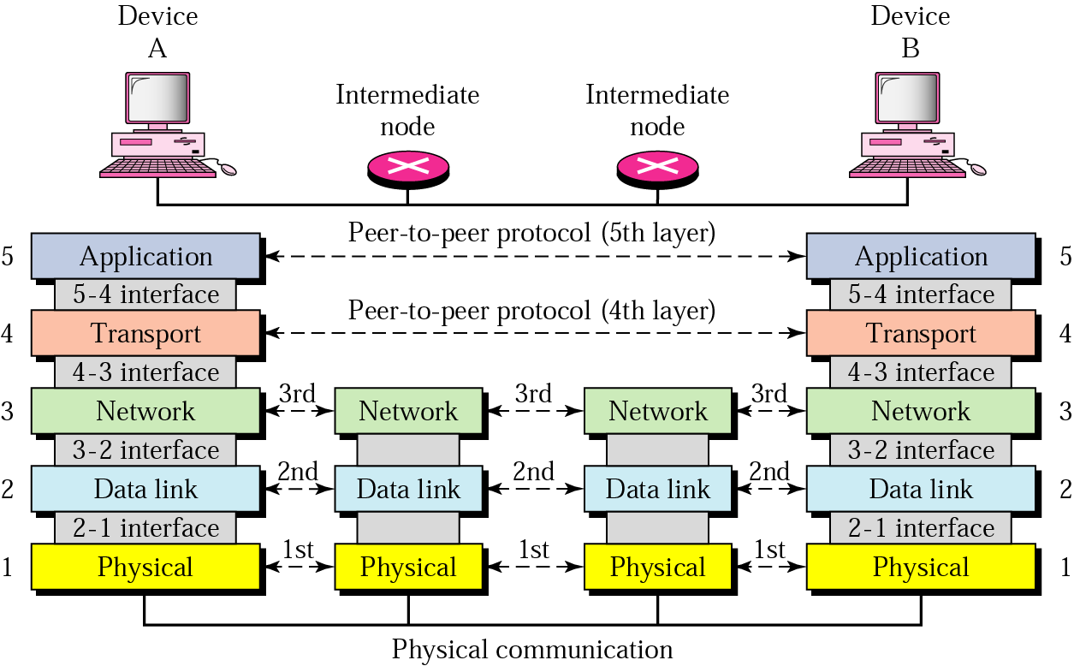
Peer-to-Peer Communication

Slide 25
Layers and Services
Service provided by TCP to HTTP:
  reliable transmission of data over a logical connection
Service provided by IP to TCP:
  unreliable transmission of IP datagrams across an IP network
Service provided by Ethernet to IP:
  transmission of a frame across an Ethernet segment
Other services:
  DNS: translation between domain names and IP addresses
  ARP: Translation between IP addresses and MAC addresses

Slide 26
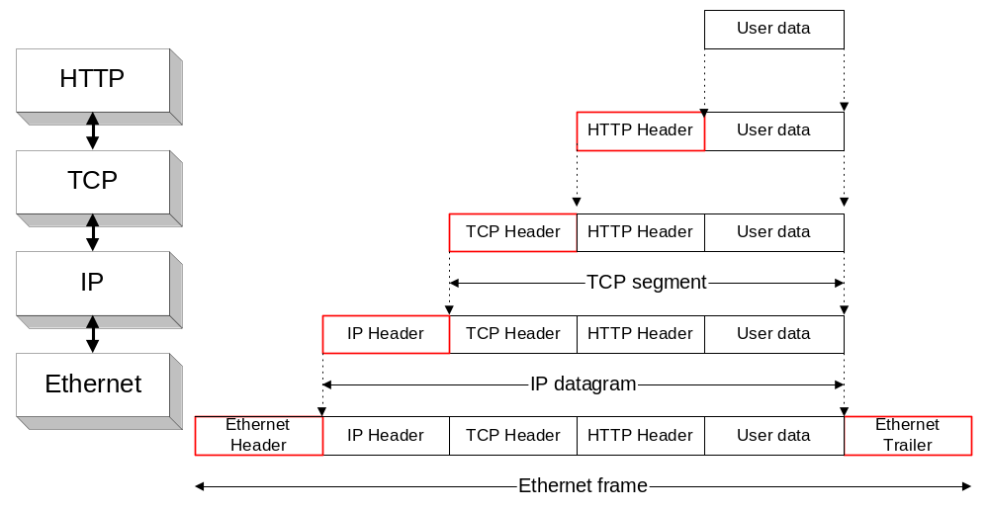
Encapsulation and Demultiplexing
As data is moving down the protocol stack, each protocol is adding layer-specific control information

Slide 27
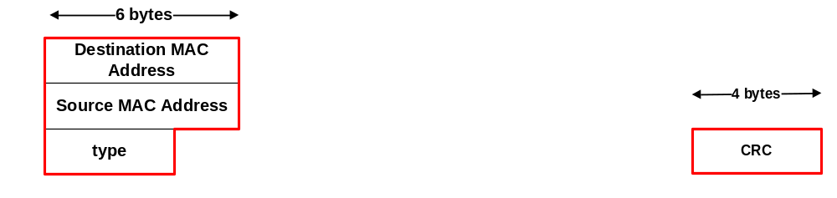
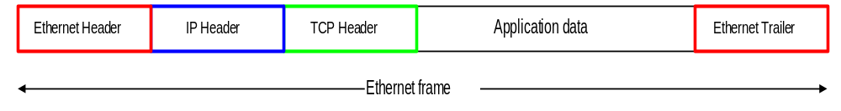
Encapsulation and Demultiplexing

Slide 28
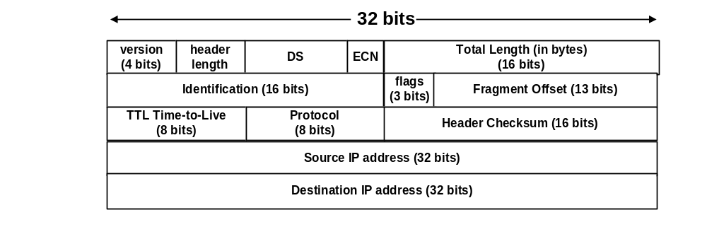
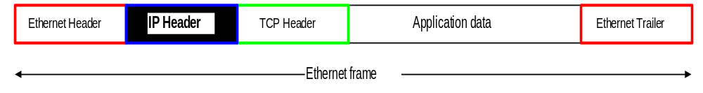
Encapsulation and Demultiplexing:
IP Header

Slide 29
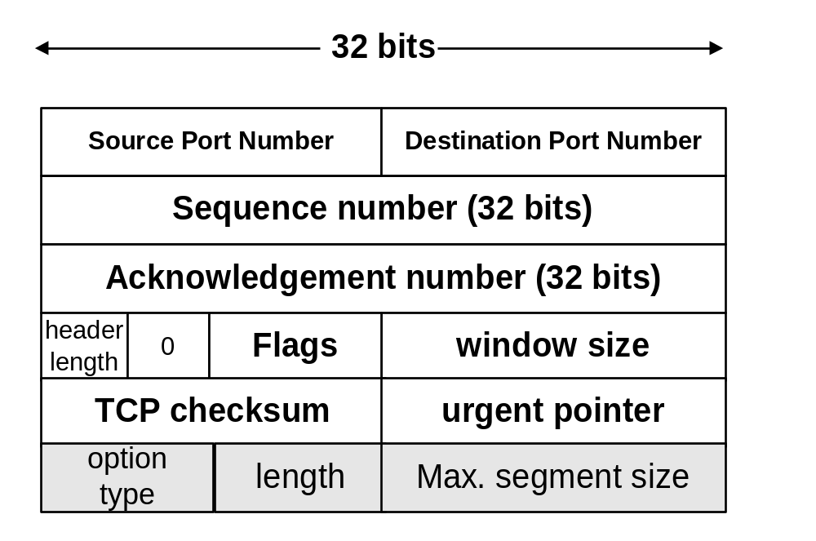
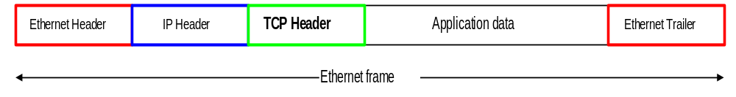
Encapsulation and Demultiplexing:
TCP Header
Option: maximum segment size

Slide 30
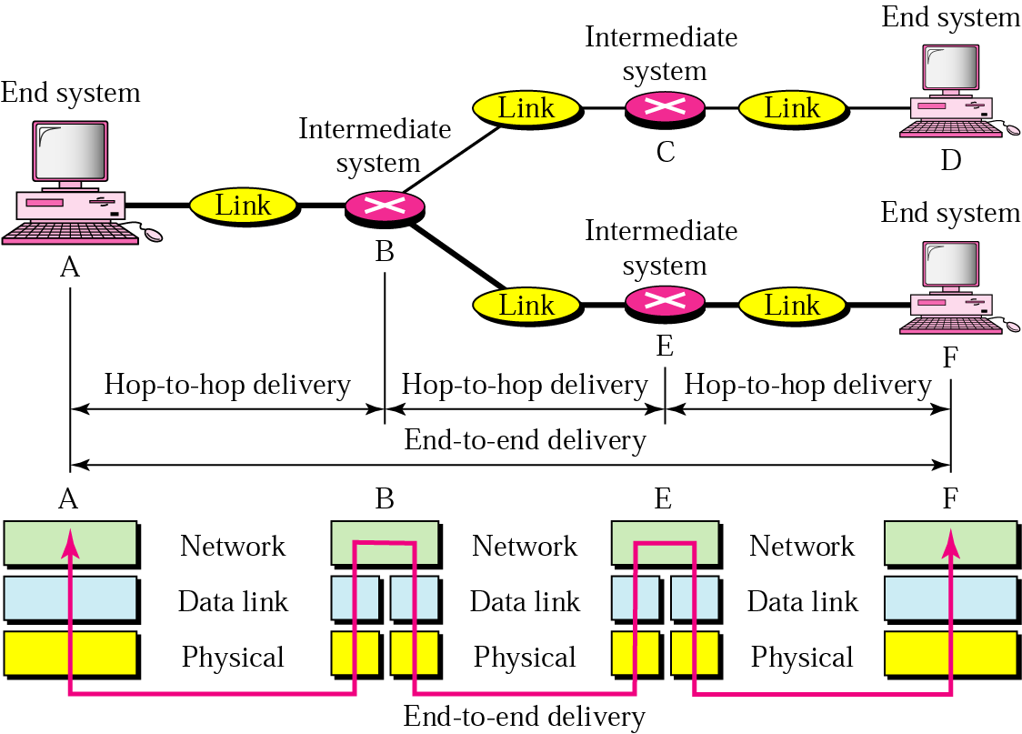
Layered Source to Destination Delivery

Slide 31
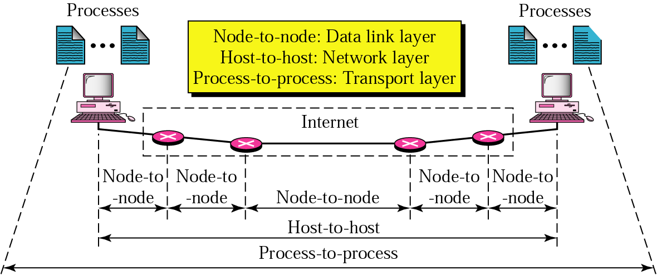
Layered Delivery

Slide 32
Protocol – A summary
Protocol in network context:
  An “agreement” between sender and receiver
    Both must be installed with the same “software”. Machine with TCP/IP only can’t communicate with machine with ATM
  Normally implemented with attaching a header or a trailer to the data
    The Header consist of control messages
  Both sender and receiver has to known what is inside in the header
    What does the bit fields represent.
  This control message known only to the corresponding layer.
    Network layer protocol is “unknown” to data link protocol
  Protocol also include the order and sequence of communication events.
    What is done first and what is done next
  Software based

Slide 33
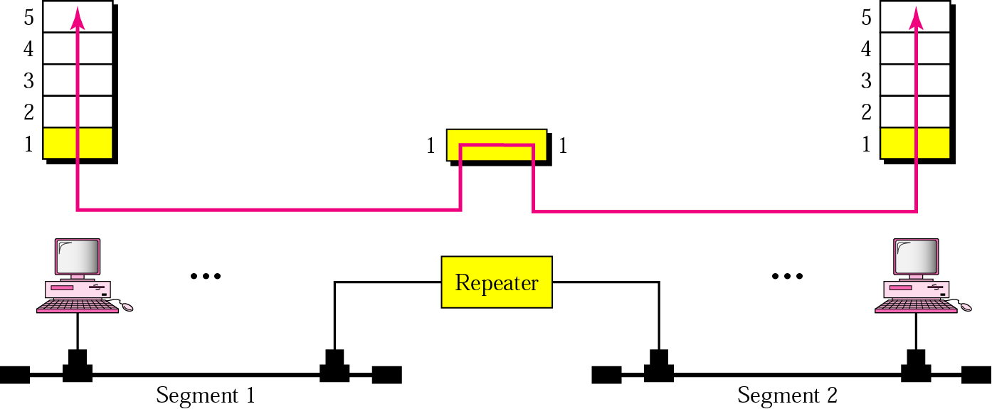
Repeater and Layer 1
Repeater or hubs does not process any header within the data.

Slide 34
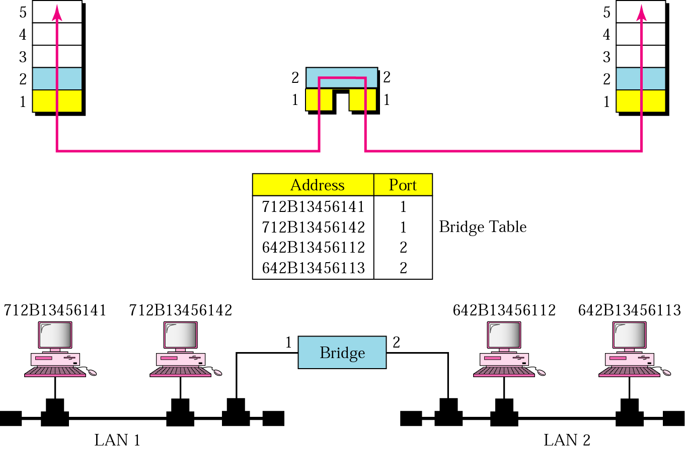
Switch and Layer 2
Bridge and switch process MAC header, and regenerate the signal.
NIC is a layer-2 device
NIC, bridge and switch DOES NOT process IP.

Slide 35
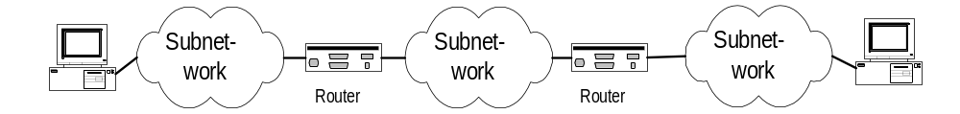
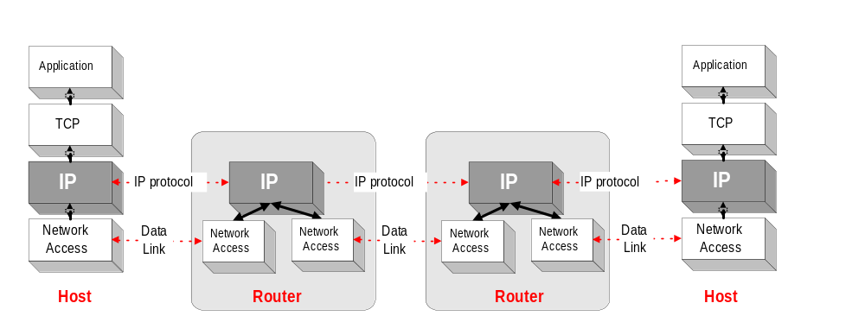
Routers and Layer 3
    Routers operate at the Network Layer (Layer 3)
    Interconnect different subnetworks

Slide 36
Router vs Switch
Routers
Uses IP address
Connecting different subnets.
More expensive
More complicated
Able to be configured
Switch
Uses MAC address
Connecting hosts into 1 subnet.
Cheaper
Simpler
Mostly can’t be configured (except managed switch)

Slide 37
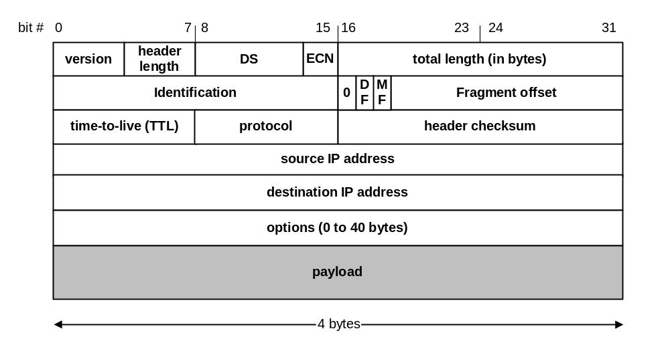
Protocol – Header – An example
A packet sniffer has captured the following data dump (in hexadecimal) at the beginning of an IP packet.
  What is the header length of the IP packet? (24 bytes)
  What is the total length of the IP packet?
  Are there any option for IP packet header?
  What is the size of the IP data?
46 00 10 73 10 00 00 00 14 06 00 00 89 28 02 54 CA E0 BD 3E 01 00 10 20 05 10 00 50 00 00 00 01 00 00 00 00 60 02 07 FF 00 00 00 00 0F…….

Slide 38
Transport Layer Protocols

Slide 39
Review - Internet Protocol Suite
The Internet protocol suite
  is the set of communications protocols that implements the protocol stack on which the Internet and many commercial networks run.
TCP/IP protocol suite, which is named after the two most important protocols in it:
  Transmission Control Protocol (TCP)
  and the Internet Protocol (IP)

Slide 40
Requirement: Data Loss?
Applications require fully reliable data transfer – straightly no data loss, otherwise disastrous
  email, instant messaging, file transfer, web transfer
Applications that are loss-tolerant, are mostly multimedia based
  Real-time audio/video or stored audio/video
  Loss data might result in a small glitch in the playout audio/video

Slide 41
Transport Protocols - Introduction
The Internet offers two transport protocols available to applications
  TCP and UDP
TCP
  Connection-oriented: Need handshake procedure (require to setup and tear down)
  Reliable: No error, no data loss, and in proper order
  Flow control: sender won’t overwhelm receiver
  Congestion control: throttle sender when network overloaded
  does not provide: timing, minimum bandwidth guarantees
UDP is
  Connectionless: No handshake, just send
  Unreliable: No guarantee that the segment will reach the receiving end.
  does not provide: connection setup, reliability, flow control, congestion control, timing, or bandwidth guarantee
  Generally sent faster than TCP

Slide 42
Usage of TCP and UDP
TCP is used by Application Layer when:
  Data integrity is an issue
  Data error is an issue
  Delay is tolerable
UDP is used by Application Layer when:
  Speed is an issue
  Delay is an issue
  Lost of data is not so critical
  Simplicity
  Reliability of data is not done in transport layer, but in application layer.

Slide 43
Transport Layer - Introduction
Provide logical communication between app processes running on different hosts
Transport protocols run in end systems
  send side: breaks app messages into segments, passes to network layer
  receiver side: reassembles segments into messages, passes to app layer

Slide 44
Function of Transport Layer
Provide port number to identify application within a host.
Chop a long stream of data bits into segments and send them off.
Reassemble the segments at the receiver.
Open and close a logical connection
Provide reliable channel.
Provide flow control.

Slide 45
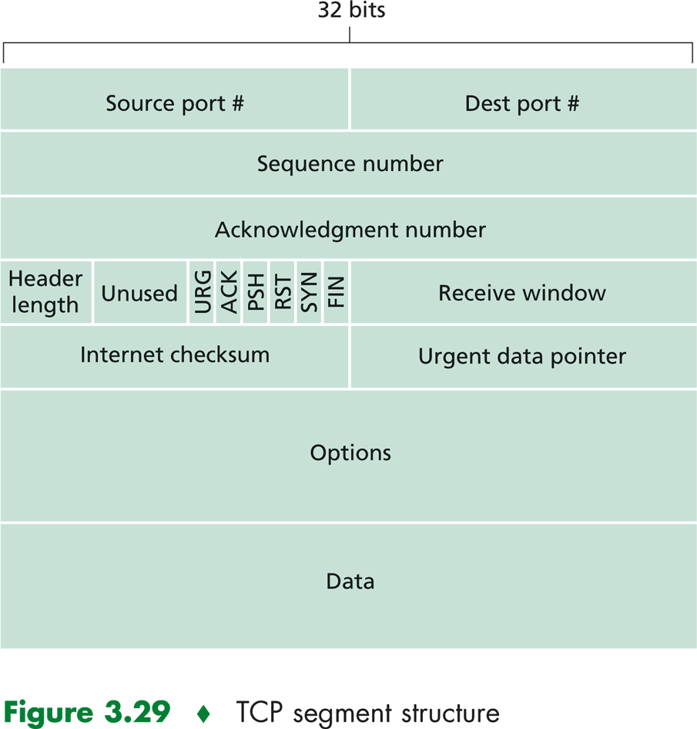
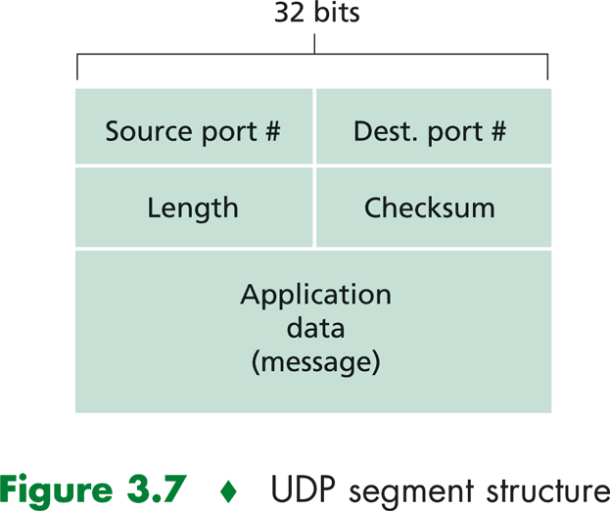
UDP and TCP Header
UDP
TCP

Slide 46
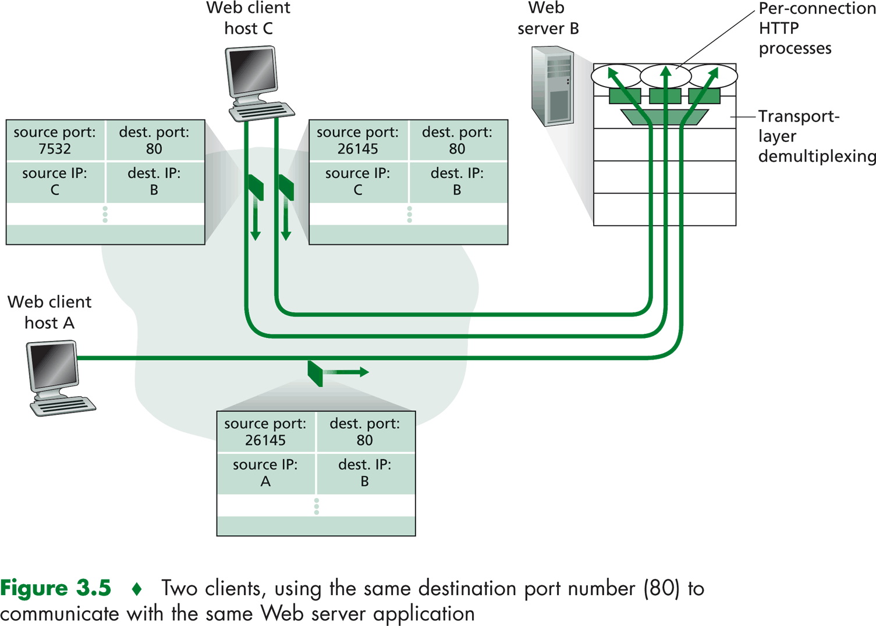
Port Numbers
Port numbers are used to identify process/programs in both servers and clients.

Slide 47
TCP Header in Detail
32 bits
URG: urgent data
(generally not used)
counting
by bytes
of data
(not segments!)
source port #
dest port #
sequence number
ACK: ACK #
valid
acknowledgement number
head
len
not
used
U
Receive window
A
PSH: push data now
(generally not used)
P
R
S
F
# bytes
rcvr willing
to accept
checksum
Urg data pnter
RST, SYN, FIN:
connection estab
(setup, teardown
commands)
Options (variable length)
application
data
(variable length)
Internet
checksum
(as in UDP)

Slide 48
TCP Header Fields
Source port
  This field identifies the sending port.
Destination port
  This field identifies the receiving port.
Sequence number
  The sequence number has a dual role. If the SYN flag is present then this is the initial sequence number and the first data byte is the sequence number plus 1. Otherwise if the SYN flag is not present then the first data byte is the sequence number.
Acknowledgement number
  If the ACK flag is set then the value of this field is the sequence number the sender expects next.

Slide 49
TCP Header Fields
Data offset
  This 4-bit field specifies the size of the TCP header in 32-bit words. The minimum size header is 5 words and the maximum is 15 words thus giving the minimum size of 20 bytes and maximum of 60 bytes. This field gets its name from the fact that it is also the offset from the start of the TCP packet to the data.
Window
  The number of bytes the sender is willing to receive starting from the acknowledgement field value
Reserved
  4-bit reserved field for future use and should be set to zero.

Slide 50
TCP Header Field
Checksum
  The 16-bit checksum field is used for error-checking of the header and data.
  When TCP runs over IPv4, the method used to compute the checksum is defined in RFC 793:
  The checksum field is the 16 bit one's complement of the one's complement sum of all 16-bit words in the header and text. If a segment contains an odd number of header and text octets to be checksummed, the last octet is padded on the right with zeros to form a 16-bit word for checksum purposes. The pad is not transmitted as part of the segment. While computing the checksum, the checksum field itself is replaced with zeros.
  In other words, all 16-bit words are summed together using one's complement (with the checksum field set to zero). The sum is then one's complemented. This final value is then inserted as the checksum field. Algorithmically speaking, this is the same as for IPv4.
  The difference is in the data used to make the checksum. Included is a pseudo-header that mimics the IPv4 header:

Slide 51
TCP Header Flags
URG: Urgent pointer is valid
  If the bit is set, the following bytes contain an urgent message in the range:
  SeqNo <= urgent message <= SeqNo+urgent pointer
ACK: Acknowledgement Number is valid
PSH: PUSH Flag
  Notification from sender to the receiver that the receiver should pass all data that it has to the application.
  Used to pass application layer header to application
RST: Reset the connection
  The flag causes the receiver to reset the connection
  Receiver of a RST terminates the connection and indicates higher layer application about the reset
  Normally means the closing of the network application
SYN: Synchronize sequence numbers
  Sent in the first packet when initiating a connection
FIN: Sender is finished with sending
  Used for closing a connection
  Both sides of a connection may send a FIN

Slide 52
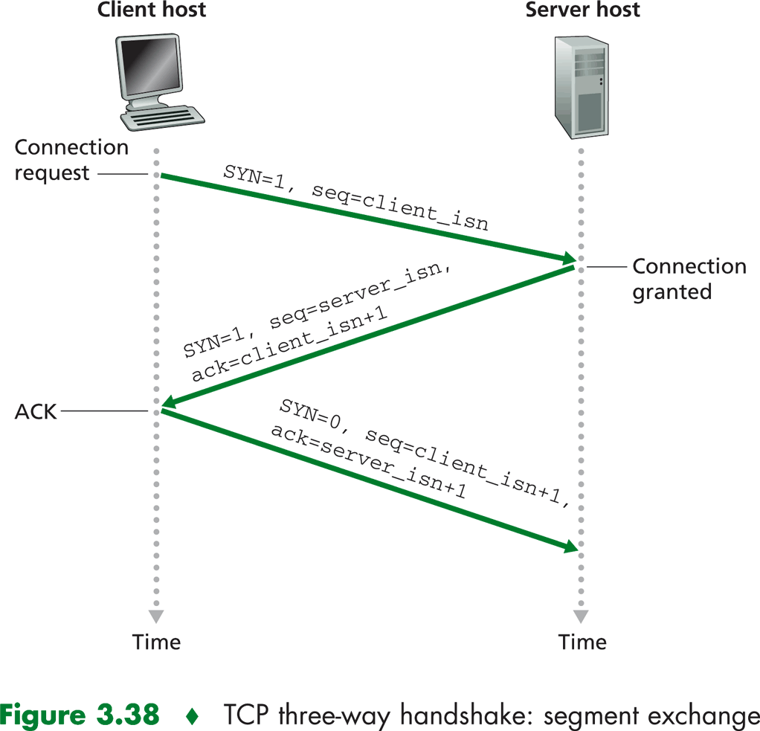
TCP: Setting UP A Connection
Three way handshake:
Step 1: client host sends TCP SYN segment to server
  specifies initial seq #
  SYN flag is set
  no data
Step 2: server host receives SYN, replies with SYN-ACK segment
  server allocates buffers
  specifies server initial seq. #
Step 3: client receives SYN-ACK, replies with ACK segment, which may contain data

Slide 53
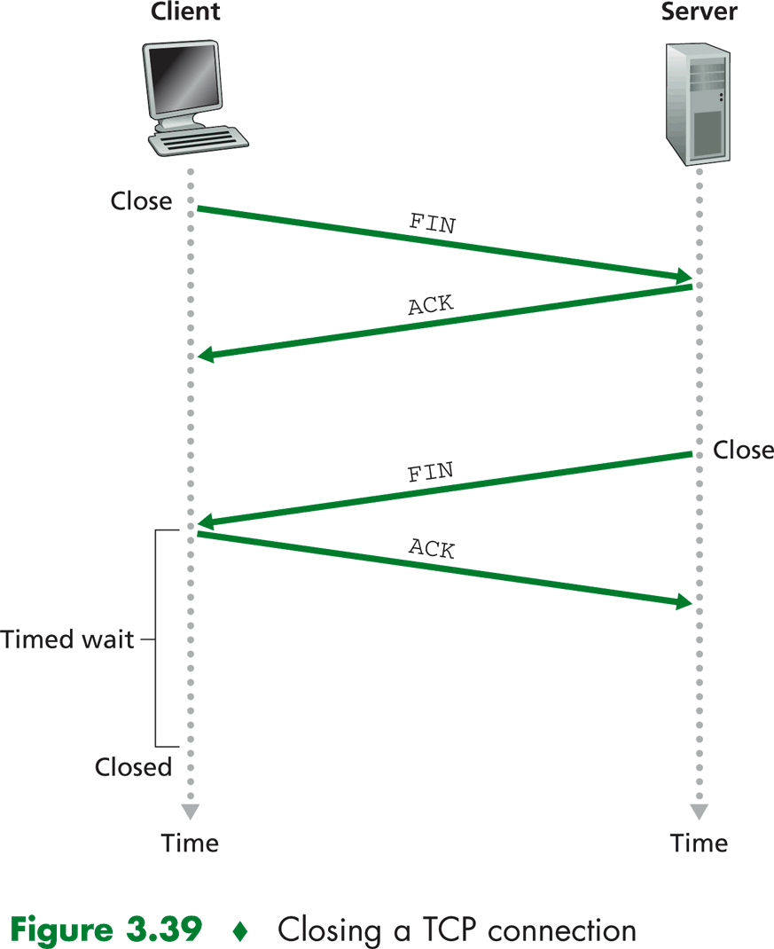
TCP: Closing a Connection
Closing a connection:
Step 1: client end system sends TCP FIN control segment to server
Step 2: server receives FIN, replies with ACK. Closes connection, sends FIN.

Slide 54
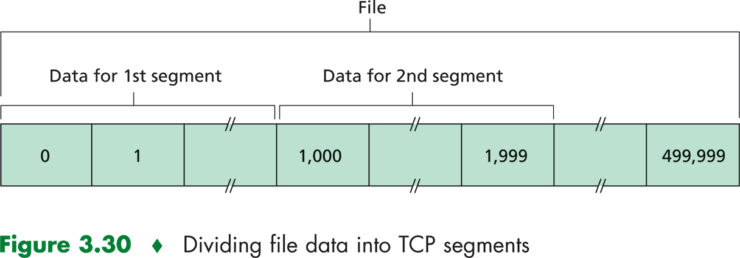
Segmenting
The maximum size of a TCP segment in PC under Ethernet is 1460, because:
  By design, maximum Ethernet frame is 1500 bytes.
  Minus off minimum size of IP header (20 bytes)
  Minus off minimum size of TCP header (20 bytes)
  1460 bytes = 1500 – 20 – 20

Slide 55
How to Implement “Reliable” connection
Through tracking the number of bytes sent
  With sequence number
Through tracking the number of bytes received
  With acknowledgment number
And various “error-correcting” mechanism
  What if the segment is lost

Slide 56
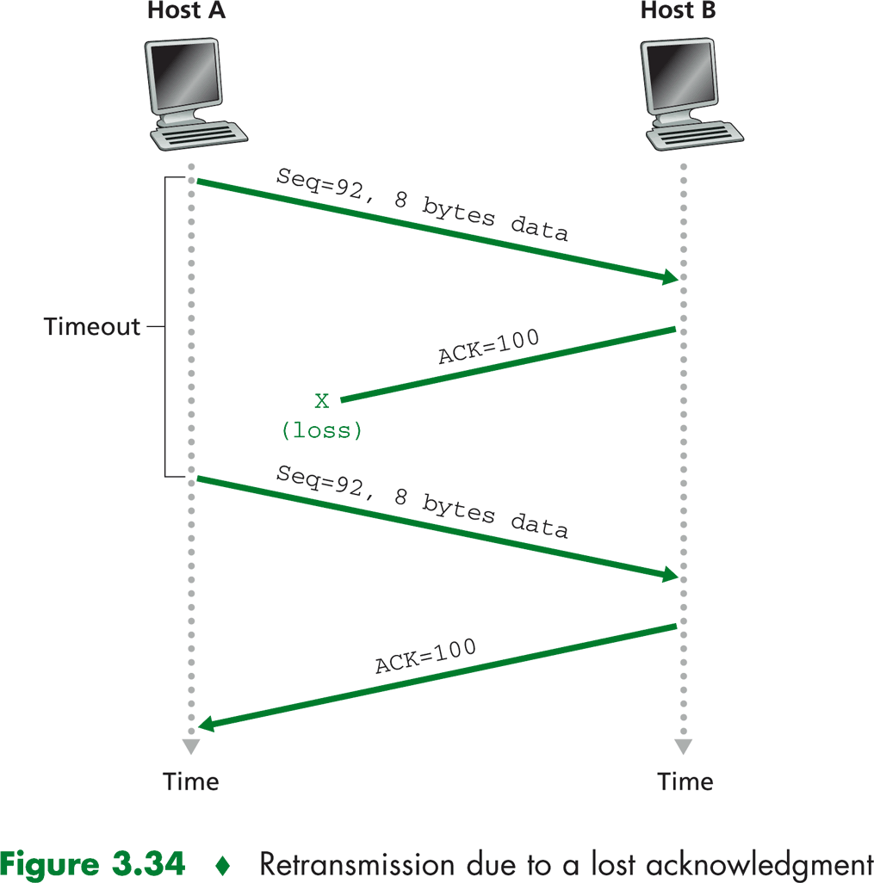
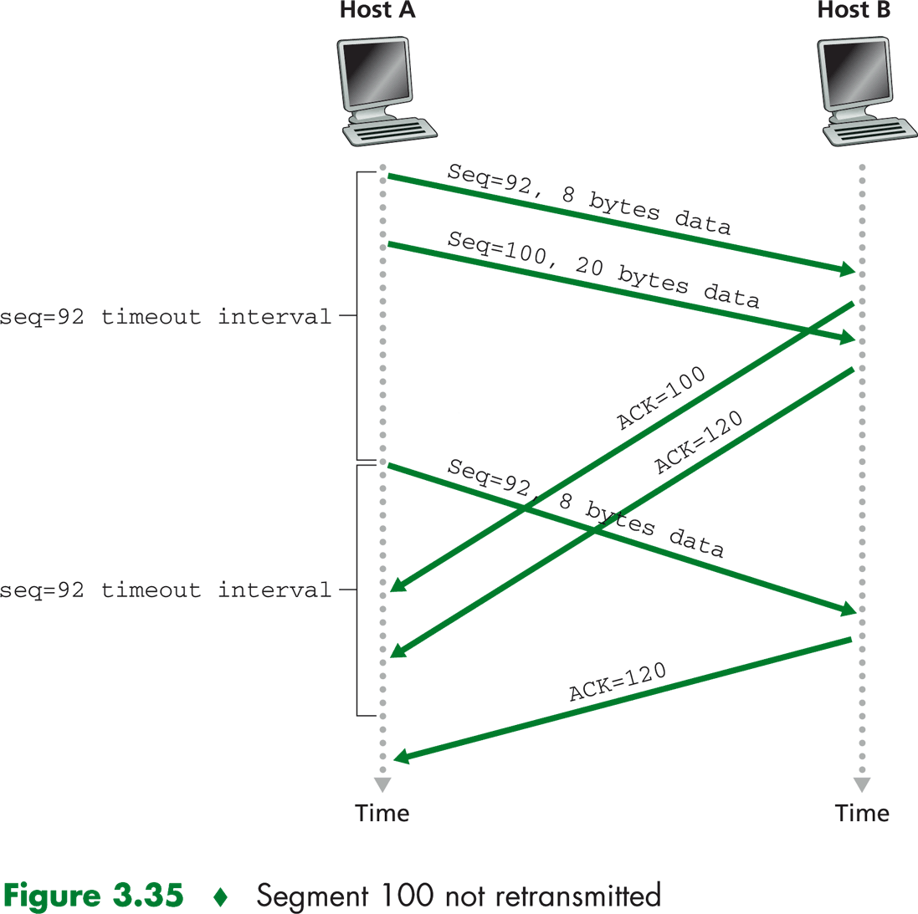
Some “transmission error” cases

Slide 57
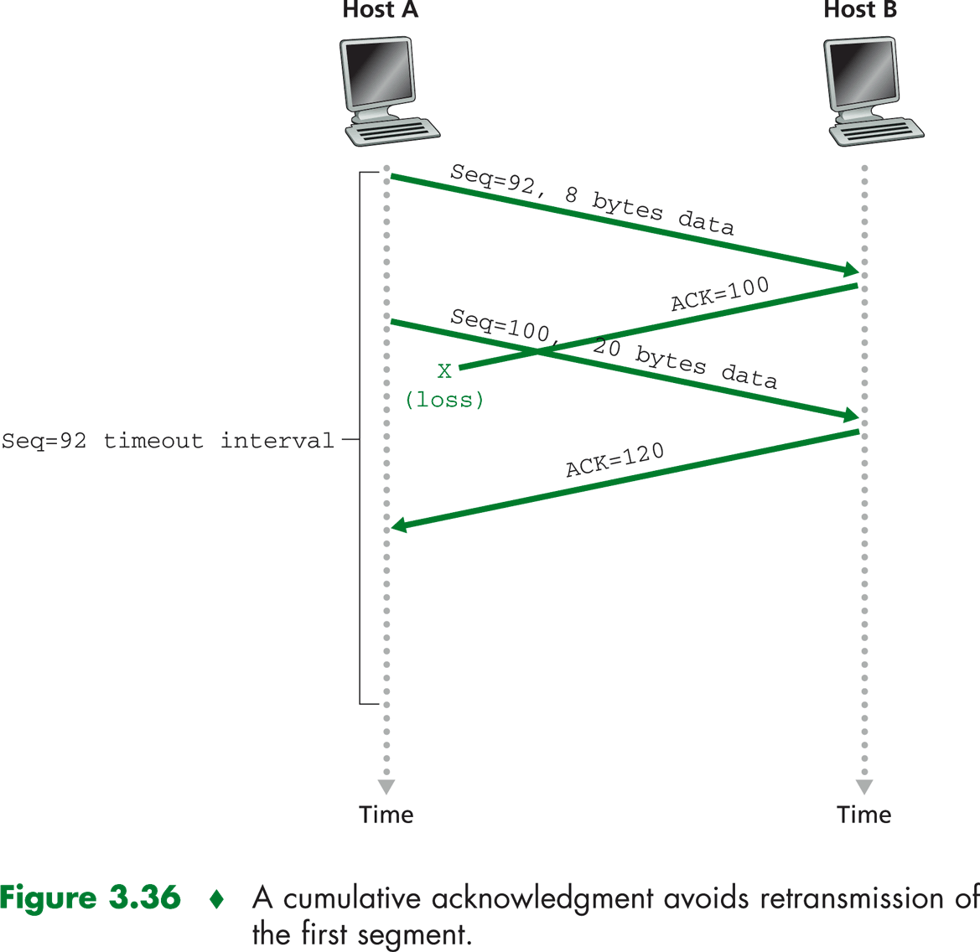
Some “acknowledgment error” case

Slide 58
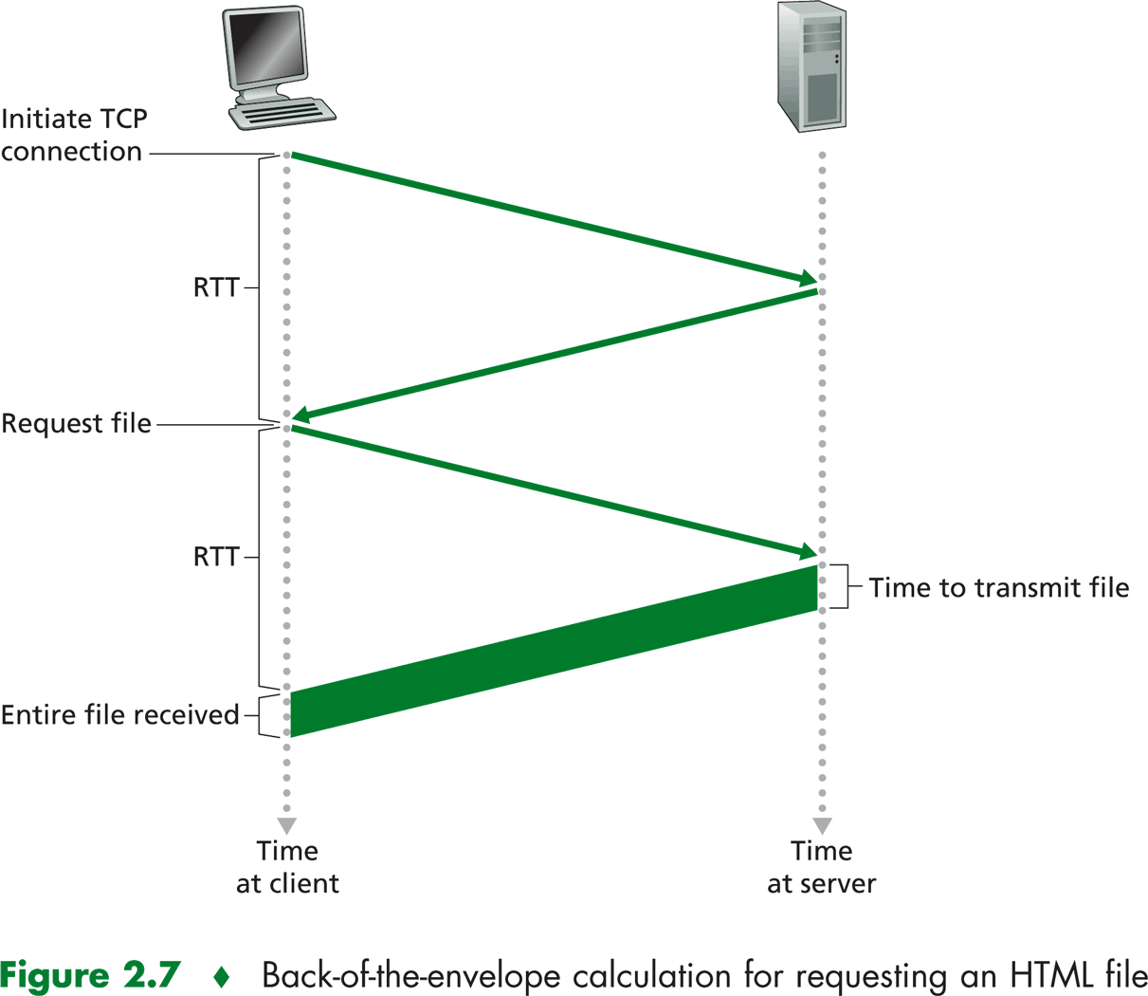
Round-Trip Time
RTT
  time to send a small packet to travel from client to server and back.

Slide 59
Intro to UDP
No “connection”, just send
  No SYN, No FIN
No reliability
  No sequence number, no acknowledgment
Transport layer still need to provide port number.
Need the speed but “best effort” service, hence UDP segment may be:
  Lost
  Delivered out of order to application (e.g. 1,2,3,4 are sent but 2,3,1,4 are received)

Slide 60
Reliable Connection with UDP?
By definition, UDP is unreliable (segment can be lost)
Reliable connection service is a SOFTWARE implementation.
  Just need to keep track of the bytes sent and received. (Sent and acknowledged)
  Just need to keep the bytes in order.
  Retransmit if the data is lost
In real world, tftp is a “reliable” application but sending data through UDP
The “reliable” mechanism is perform in APPLICATION layer, instead of transport layer (as in FTP with TCP).

Slide 61
UDP checksum
Goal: detect “errors” (e.g., flipped bits) in transmitted segment
Sender:
treat segment contents as sequence of 16-bit integers
checksum: addition (1’s complement sum) of segment contents
sender puts checksum value into UDP checksum field
Receiver:
compute checksum of received segment
check if computed checksum equals checksum field value:
  NO - error detected
  YES - no error detected.

Slide 62
Internet Checksum Example
Note
  When adding numbers, a carryout from the most significant bit needs to be added to the result
Example: add two 16-bit integers
1 1 1 1 0 0 1 1 0 0 1 1 0 0 1 1 0
1 1 1 0 1 0 1 0 1 0 1 0 1 0 1 0 1
1 1 0 1 1 1 0 1 1 1 0 1 1 1 0 1 1
1 1 0 1 1 1 0 1 1 1 0 1 1 1 1 0 0
1 0 1 0 0 0 1 0 0 0 1 0 0 0 0 1 1
wraparound
sum
checksum

Slide 63
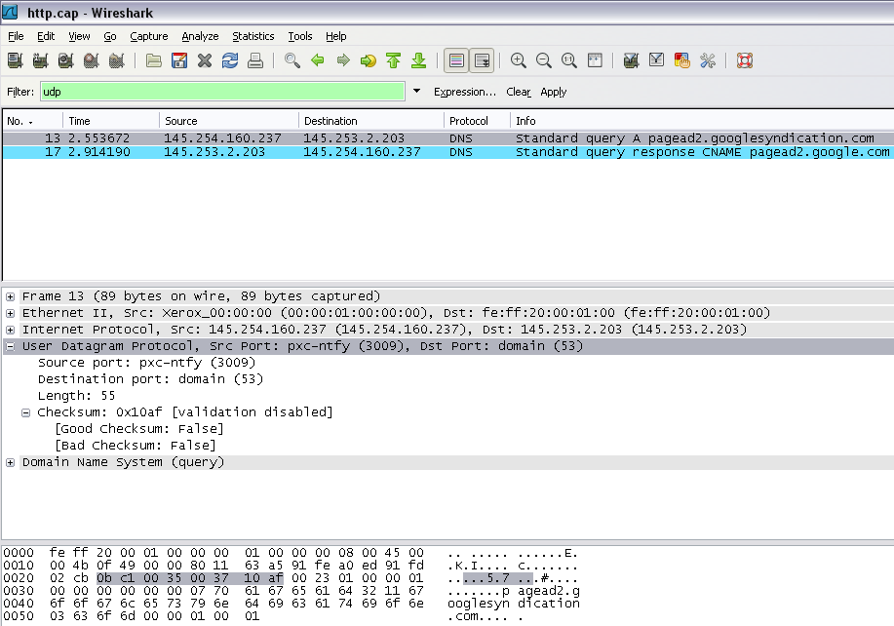
UDP - Wireshark Example

